Slide 1
Regular grammars
Simplest; less powerful than context-free grammar
Equivalent to:
Regular expression
Finite-state automaton
A regular grammar is a context free grammar where every production is of one of the two forms:
X → aY
X → a
for X, Y ∈ Nonterminal, a ∈ Terminal
Theorem: L(G) for regular grammar G is equivalent to L(M) for FSA M.

Slide 2
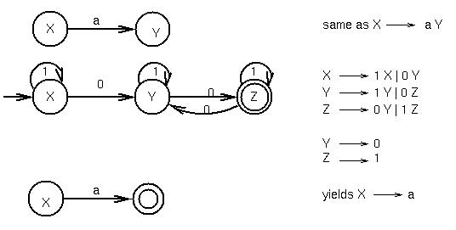
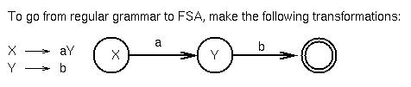
Equivalence of FSA and regular grammars

